Slide 1


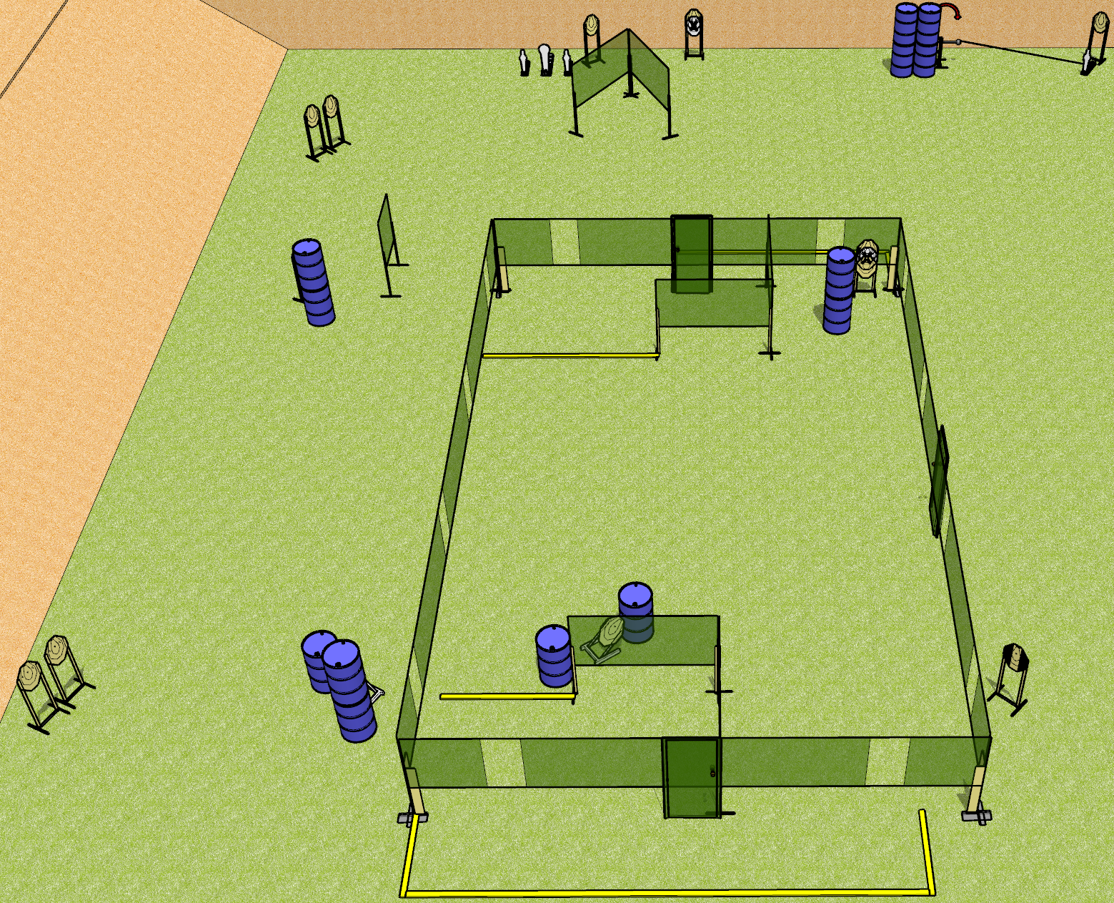
 | Dothan Gun Club – USPSA Match One End to the Other Course Designer : Drew Coleman
Round Count 32 rounds 14 IPSC 2 colt poppers, 2 mini poppers
Equipment List 6 wall feet 4 medium fault lines 1 tux

Slide 2
One End to the Other
Written Stage Briefing
One End to the Other is a 32 round, 160 point, Comstock course of fire. There are 14 IPSC targets, 2 colt poppers, and 2 mini poppers. The best 2 hits on paper will score, and steel must fall to score. The start signal is audible.
The swinger is activated by the right mini popper and remains visible at rest.
Handgun start position is inside the shooting area, wrists below belt. Pistol is loaded and holstered.
PCC start position is inside the shooting area, stock on belt. Loaded carbine is held with both hands, safety on.
On start signal, engage targets as they become available from within the shooting area.

